Slide 1
Bangla Fake News Detection

Slide 2
Presented By Supervised By
Puja Kundu
ID: CE17027
Murshada Akter
ID: CE17029
Lubna Yasmin Pinky
Assistant Professor
Department of Computer Science and Engineering, MBSTU

Slide 3
Introduction
Fake news is false or misleading information presented as true and accurate news. It is designed to deliberately spread hoaxes, propagation, and disinformation. It has become a major phenomenon in the context of Internet-based media. Fake news is usually spread through social media sites like Facebook, Twitter, or online news sites. Although there are websites to tackle fake news, there are limited resources to detect fake news written in the Bangla language. Our proposed approach is to use machine learning techniques for fake news detection in the Bangla language.

Slide 4
Problem Statement
The spreading of fake news has become a concerning issue. According to a national survey conducted by the Management and Resources Development Initiative (MRDI), 63.6 percent of people have encountered with fake news online. Although there are fact-checking websites, most of them work for the English language. These websites are not able to sufficiently respond to many fake news incidents. To overcome these limitations, it is essential to build a model that can process Bengali letters and words to detect fake news.

Slide 5
Related Work
BanFakeNews: A Dataset for Detecting Fake News in Bangle Shahjalal University of Science and Technology, Sylhet, Bangladesh
Findings | Merits/Future Work | Demerits
Linear classifiers with traditional linguistic features can perform better than the neural based model Character level features are more significant than word level features The use of punctuation is more frequent in fake news Fake news is found on least popular sites | First labeled dataset on Bangla Fake News Expansion of dataset | The number of authentic news is 37.47 times higher than the number of fake news.

Slide 6
Related Work
FakeDetect: Bangla Fake News Detection Model based on Different Machine Learning Classifiers Brac University, Bangladesh
Findings | Merits/Future Work | Demerits
Most of the models achieved accuracy of over 90% Passive Aggressive Classifier and Support Vector Machine worked better than other machine learning classifiers. Classifiers work better with TF-IDF (Term Frequency and Inverse Document Frequency) | Work on browser extension that would show the result immediately on fake news detection Adopt Bidirectional Encoder Representations from Transformers | Lack of fake news dataset Lack of tools to work with Bangla natural language processing

Slide 7
Related Work
A Study towards Bangla Fake News Detection Using Machine Learning and Deep Learning Publication: https://www.researchgate.net/publication/355628396
Findings | Merits/Future Work | Demerits
Better performance with deep learning models compared to the traditional machine learning model Passive Aggressive Classifier and Support Vector Machine worked better than other machine learning classifiers. | Work on limitations | Lack of resource for Bangla language No sufficient library

Slide 8
Dataset Description
A dataset in machine learning is a collection of a related and discrete item of related data that can be treated by a computer as a single unit for analytic and prediction purposes. For our model, we have collected an annotated dataset built by the researcher from SUST, Bangladesh. The data are gathered together from a lot of news websites and portals. The dataset contains two .csv files named as –
Authentic-48K.csv
Fake-1K.csv
This is a labeled dataset where around 48k news is authentic and around 1.3k news is fake.

Slide 9
Dataset Description
Column Name | Description
ArticleId | Serial number of the news
Domain | Website address from where the source is extracted
Date | Published date
Category | Type of news
Headline | Headline of the news
Content | Body of the news
Label | Information whether the news is fake or authentic

Slide 10
Methodology
Dataset
The steps in this procedure are as follows –
Dataset Loading
Dataset Concatenation
Data Preprocessing
Feature Extraction
Training Dataset
Applying Classification Model
Classifying data
Predicting fake or real news
Concatenation
Pre-processing
Feature Extraction
Training
Classification Model
Prediction
Fake News
Real News

Slide 11
Data Loading and Concatenaton
Load data from Authentic48K.csv and Fake1K.csv file
Concatenate the two files.
Shuffle the merged dataset
Reset index
Merge ‘headline’ and ‘content’ column

Slide 12
Data Preprocessing
Data Preprocessing
Filling null values
Stopword removal
Punctuation removal
URL removal
Stemming
Filling missing data
Stopword removal
Punctuation removal
URL removal
Stemming

Slide 13
Feature Extraction
Feature extraction refers to the process of transforming raw data into numerical features. One of the best feature extraction technique is Term Frequency-Inverse Document Frequency(TF-IDF). TF-IDF converts text data into useful features.
Term Frequency(TF): It finds out the number of repetitions of a word in a sentence.
Inverse Document Frequency(IDF): It measures how common or rare a word is in a sentence.

Slide 14
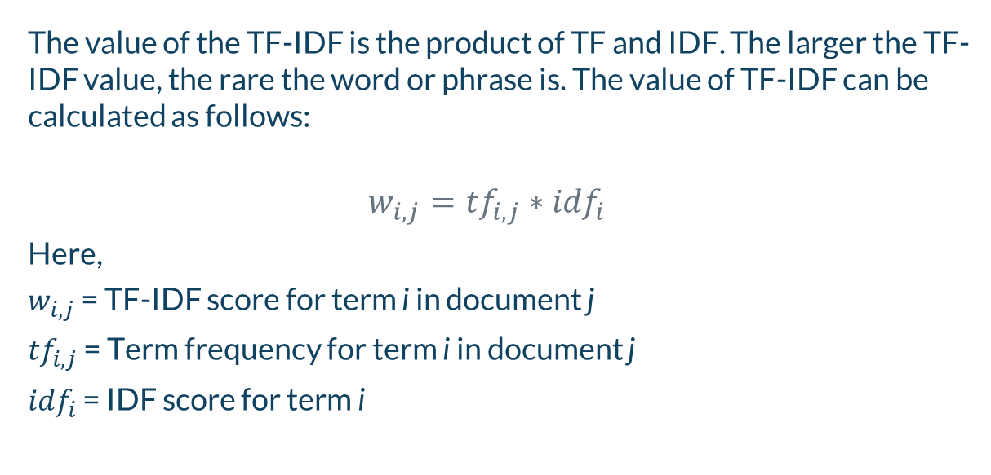
The value of the TF-IDF is the product of TF and IDF. The larger the TF-IDF value, the rare the word or phrase is. The value of TF-IDF can be calculated as follows:
$$w_{i,j}={tf}_{i,j}∗{idf}_{i}$$
Here,
$w_{i,j}$ = TF-IDF score for term i in document j
${tf}_{i,j}$ = Term frequency for term i in document j
${idf}_{i}$ = IDF score for term i

Slide 15
Training and Testing Dataset
In machine learning, datasets are split into two subsets.
Training data: A subset to train a model
Testing data: A subset to test the trained model
We will use Scikit-learn’s train_test_split() function to split our dataset. The function parameters are -
train_test_split(*arrays,test_size,train_size,random_state,shuffle,stratify)
Training Data
Testing Data

Slide 16
Classification Models
Classification models are a subset of supervised machine learning. A classification model reads some input and generates an output that classifies the input into some category. For our model, classification models will predict if a piece of news is either real or fake.
The models we will use for our prediction system are –
Logistic Regression
Random Forest
Naïve Bayes
Decision Tree

Slide 17

Logistic Regression
Logistic regression is basically a supervised classification algorithm. In a classification problem, the target variable (or output), Y, can take only discrete values for a given set of features (or inputs), X. Logistic regression is used for solving the classification problems.
Logistic regression has two phases – Training and Test.
Logistic regression models the data using the sigmoid function.
$${g\left(z\right)}^{ }=\frac{1}{1+e^{−z}}$$

Slide 18
Random Forest
Random Forest is a classifier that contains a number of decision trees on various subsets of the given dataset and takes the average to improve the predictive accuracy of that dataset. Instead of relying on one decision tree, the random forest takes the prediction from each tree, and based on the majority votes of predictions, it predicts the final output.
Decision Tree
Decision Tree
Decision Tree
Averaging
Prediction

Slide 19

Multinomial Naïve Bayes
The multinomial naïve bayes is widely used for assigning documents to classes based on the statistical analysis of their contents.
The classification aims to assign fragments of text (i.e. documents) to classes by determining the probability that a document belongs to the class of other documents, having the same subject.
Probability of a class, $P\left(c\right)=\frac{N_{c}}{N}$
Likelihood of a word given a class, $P\left(c\right)=\frac{count\left(w,c\right)+1}{count\left(c\right)+|v|}$

Slide 20
Decision Tree
Decision Tree is a Supervised learning technique that can be used for both classification and Regression problems. It is a tree-structured classifier, where features of a dataset, branches represent the decision rules and each leaf node represents the outcome.
In a Decision tree, there are two nodes, which are –
Decision Node
Leaf Node
Decision nodes are used to make any decision and have multiple branches, whereas Leaf nodes are the output of those decisions and do not contain any further branches.

Slide 21
Expected Output
Find accuracy, precision, recall, and f1-score.
Determine the best-performing model.
Predicting fake news or real news of given input.
Input
yes
Is the news fake?
no
The news is fake
The news is real

Slide 22
Limitations
Lack of fake news dataset in Bangla language
Lack of tools to work with the Bangla dataset
Lack of sufficient libraries to work with the Bangla language
More and more data pre-processing is required for high accuracy level

Slide 23
Conclusion
Fake news content not only appears in the English language but is also seen in the other native languages. Through our proposed model, we will be able to classify fake news precisely with different machine learning classifiers. We will also be able to manually input a piece of news to predict if the news is real or fake. Multiple classifiers have been used to
get a big picture of how these classifiers work on Bangla fake news. In the future, if researchers want to research in this field they can get a decent idea about which classifier to use for their model.

Slide 24
Thank you!

